Slide 1

Class 7 – K Nearest Neighbors (KNN) Regression
Pedram Jahangiry
Fall 2019

Slide 2
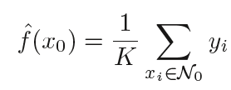
Linear Regression versus KNN Regression
If the specified functional form is far from the truth, and prediction accuracy is our goal, then the parametric method will perform poorly. For instance, if we assume a linear relationship between X and Y but the true relationship is far from linear, then the resulting model will provide a poor fit to the data, and any conclusions drawn from it will be suspect.
In contrast, non-parametric methods do not explicitly assume a parametric form for f(X), and thereby provide an alternative and more flexible approach for performing regression.
KNN is one of the simplest and best-known non-parametric methods
The KNN regression method is closely related to the KNN classifier
Notes:
Given a value for K and a prediction point x0, KNN regression first identifies the K training observations that are closest to x0, represented by N0. It then estimates f(x0) using the average of all the training responses in N0. In other words,

Slide 3
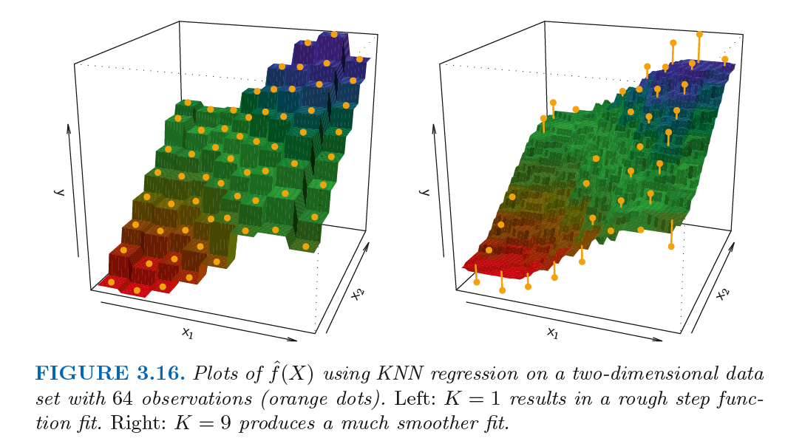
Linear Regression versus KNN Regression
In general, the optimal value for K will depend on the bias-variance tradeoff. What is the trade off? Model Flexibility?
Notes:
A small value for K provides the most flexible fit, which will have low bias but high variance. This variance is due to the fact that the prediction in a given region is entirely dependent on just one observation. In contrast, larger values of K provide a smoother and less variable fit; the prediction in a region is an average of several points, and so changing one observation has a smaller effect. However, the smoothing may cause bias by masking some of the structure in f(X).

Slide 4
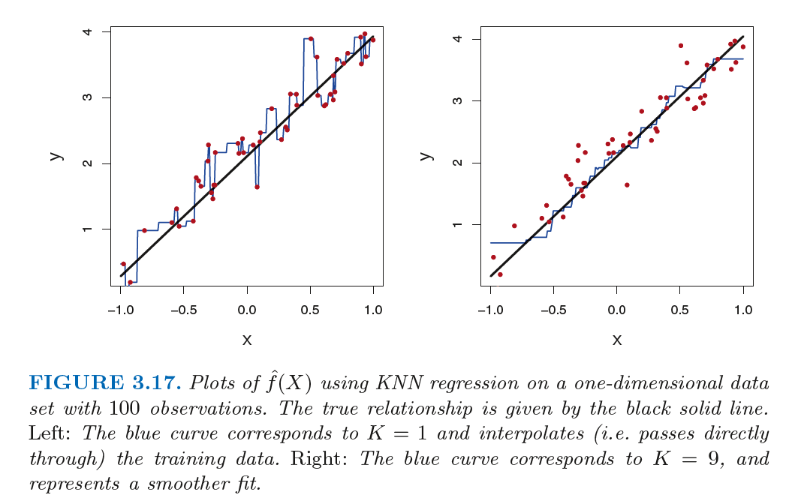
Linear Regression versus KNN Regression
Notes:
In what setting will a parametric approach such as least squares linear regression outperform a non-parametric approach such as KNN regression? The answer is simple: the parametric approach will outperform the nonparametric approach if the parametric form that has been selected is close to the true form of f.
When the true relation is know and linear, a non-parametric approach incurs a cost in variance that is not offset by a reduction in bias.

Slide 5
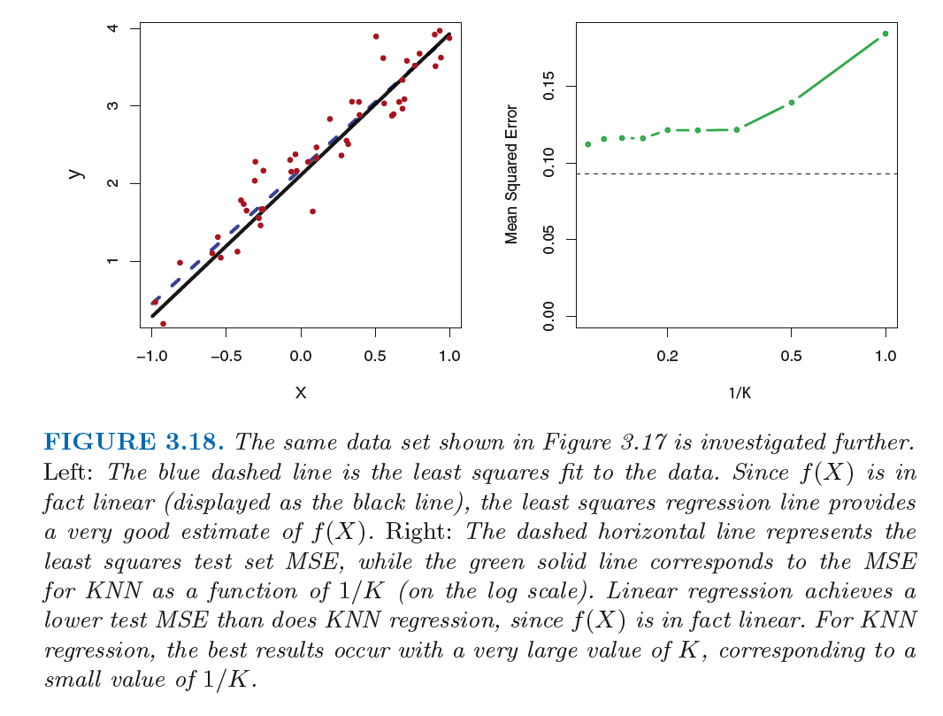
Linear Regression versus KNN Regression
Notes:
In what setting will a parametric approach such as least squares linear regression outperform a non-parametric approach such as KNN regression? The answer is simple: the parametric approach will outperform the nonparametric approach if the parametric form that has been selected is close to the true form of f.
When the true relation is know and linear, a non-parametric approach incurs a cost in variance that is not offset by a reduction in bias.

Slide 6
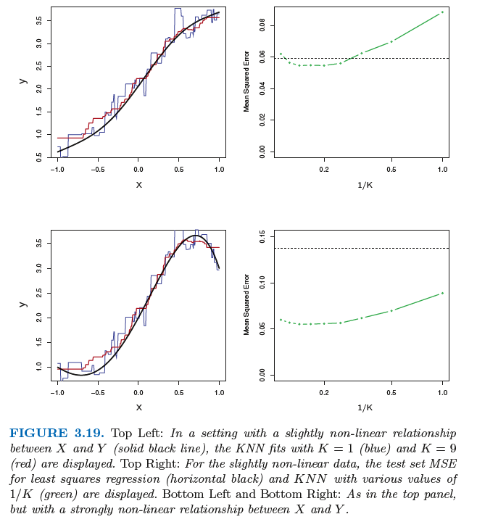
Notes:
In practice, the true relationship between X and Y is rarely exactly linear. Figure 3.19 examines the relative performances of least squares regression and KNN under increasing levels of non-linearity in the relationship between X and Y .

Slide 7
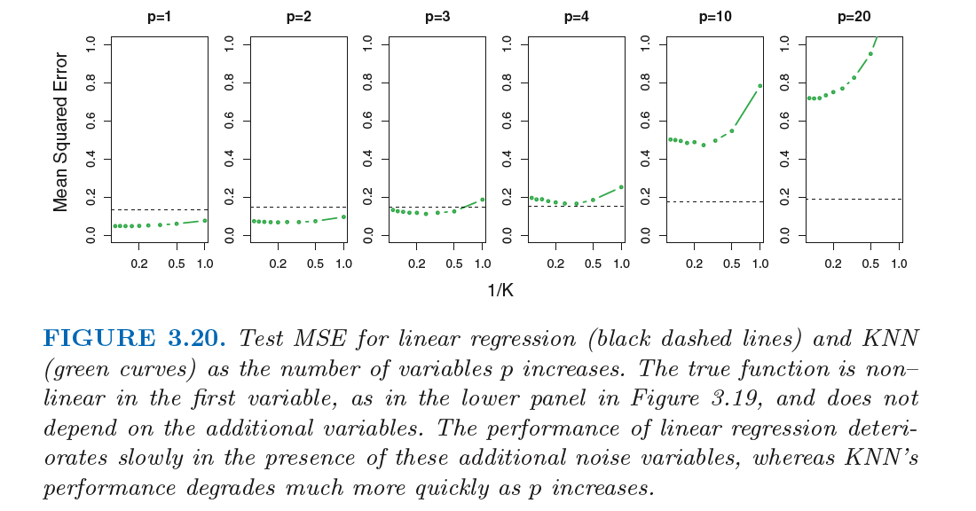
Linear Regression versus KNN Regression
Notes:
In a real life situation in which the true relationship is unknown, one might draw the conclusion that KNN should be favored over linear regression because it will at worst be slightly inferior than linear regression if the true relationship is linear, and may give substantially better results if the true relationship is non-linear. But in reality, even when the true relationship is highly non-linear, KNN may still provide inferior results to linear regression. In particular, both Figures 3.18 and 3.19 illustrate settings with p = 1 predictor. But in higher dimensions, KNN often performs worse than linear regression.
When p = 1 or p = 2, KNN outperforms linear regression. But for p = 3 the results are mixed, and for p ≥ 4 linear regression is superior to KNN. In fact, the increase in dimension has only caused a small deterioration in the linear regression test set MSE, but it has caused more than a ten-fold increase in the MSE for KNN. This decrease in performance as the dimension increases is a common problem for KNN, and results from the fact that in higher dimensions there is effectively a reduction in sample size. In this data set there are 100 training observations; when p = 1, this provides enough information to accurately estimate f(X). However, spreading 100 observations over p = 20 dimensions results in a phenomenon in which a given observation has no nearby neighbors—this is the so-called curse of dimensionality. That is, the K observations that are nearest to a given test observation x0 may be very far away from x0 in p-dimensional space when p is large, leading to a very poor prediction of f(x0) and hence a poor KNN fit. As a general rule, parametric methods will tend to outperform non-parametric approaches when there is a small number of observations per predictor.
Even in problems in which the dimension is small, we might prefer linear regression to KNN from an interpretability standpoint. If the test MSE of KNN is only slightly lower than that of linear regression, we might be willing to forego a little bit of prediction accuracy for the sake of a simple model that can be described in terms of just a few coefficients, and for which p-values are available.

